Slide 1

Mini Project 2
March 2021
Jin Yang

Slide 2
Background
As at 19 March 2021, there are 1,990 companies listed on ASX (ASX, 2020).
Share market is risky and uncertain.
In addition to the volatile market, retail investors can make a huge loss when the firms fail and are removed from the share market.
Over 6,500 companies have been delisted from ASX, Newcastle Stock Exchange, and Bendigo Stock Exchange over the past 100 odd years. (Investogain Pty Ltd, 2021).
Can investors minimize the risk of investing in a company that may fail and is removed from the market?

Slide 3
Business Question
Can we predict the failure and removal of ASX listed firms from the market based on financial ratios?
Objectives
  To investigate the variation in the financial ratios between listed and delisted firms.
  To examine whether the final financial information can help to model and predict the likelihood of ASX listed firms to fail and be delisted using various classification model.
  Can the final years of financial information able to tell us about whether the companies will be removed from the market?

Slide 4
Pipeline
Data source
  Financials from Morningstar database (for the period 2011 to 2019)
Clean & Exploring
  Summary statistics and correlation matrix
  Performed standardization and SMOTE for under-sampling
Visualization
  Line graph and box plots
Build Models
  Logistic regression
  Support Vector Machine
  Naïve Base
  Cross validation

Slide 5
Financial ratios
Liquidity ratios
  Current ratio = Current assets / Current liabilities
  Quick ratio = Current assets / Current liabilities
Solvency ratios
  Debt to Asset ratio = Total debt / Total Assets
  Debt to Equity ratio = Total debt / Total equity
  Interest Coverage ratio = (NPAT + Interest expenses + tax expenses) / Interest expenses
Profitability ratios
  ROE = NPAT / Total equity
  ROA = NPAT / Total Assets

Slide 6
Summary statistics (2010-2019)
 | count | mean | std | min | 25% | 50% | 75% | max
Current Ratio | 16,206 | 5.85 | 8.30 | 0.17 | 1.09 | 2.27 | 6.48 | 32.22
Quick Ratio | 16,206 | 5.39 | 8.12 | 0.10 | 0.74 | 1.76 | 5.89 | 31.18
Debt to Asset | 16,206 | 0.34 | 0.33 | 0.02 | 0.07 | 0.26 | 0.50 | 1.24
Debt to Equity | 16,206 | 0.80 | 1.11 | 0.02 | 0.08 | 0.35 | 1.00 | 4.35
Interest Coverage | 16,206 | 0.44 | 0.50 | 0.00 | 0.00 | 0.00 | 1.00 | 1.00
ROE | 16,206 | -0.48 | 0.97 | -3.62 | -0.54 | -0.11 | 0.07 | 0.28
ROA | 16,206 | -0.33 | 0.62 | -2.28 | -0.40 | -0.09 | 0.04 | 0.17
d_loss | 16,206 | 0.64 | 0.48 | 0.00 | 0.00 | 1.00 | 1.00 | 1.00
delisted | 16,206 | 0.10 | 0.30 | 0.00 | 0.00 | 0.00 | 0.00 | 1.00

Slide 7
T-Test statistics
Variables | T-stat | p-value | Reject (Yes/No)
Current Ratio | -8.097 | 0.000 | REJECT
Quick Ratio | -8.004 | 0.000 | REJECT
Debt to Asset | 20.905 | 0.000 | REJECT
Debt to Equity | 15.911 | 0.000 | REJECT
Interest Coverage | 4.827 | 0.000 | REJECT
ROE | -3.697 | 0.000 | REJECT
ROA | -2.887 | 0.004 | REJECT

Slide 8
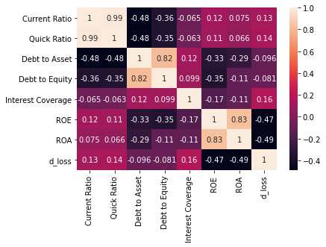
Correlation between key variables

Slide 9
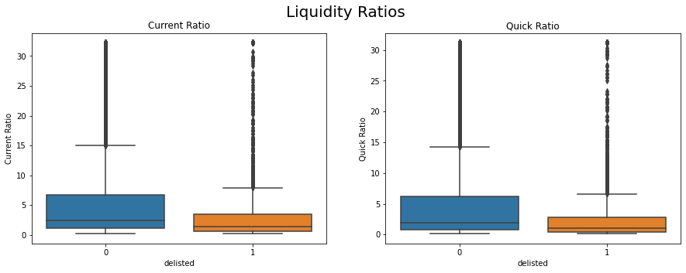
Liquidity Ratios

Slide 10
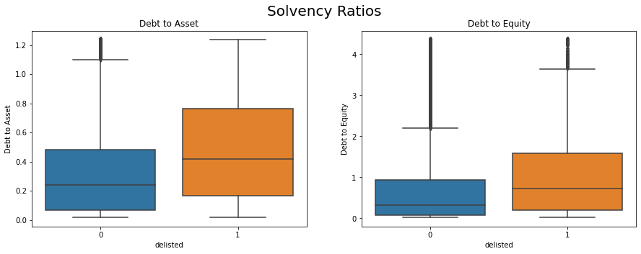
Solvency Ratios

Slide 11
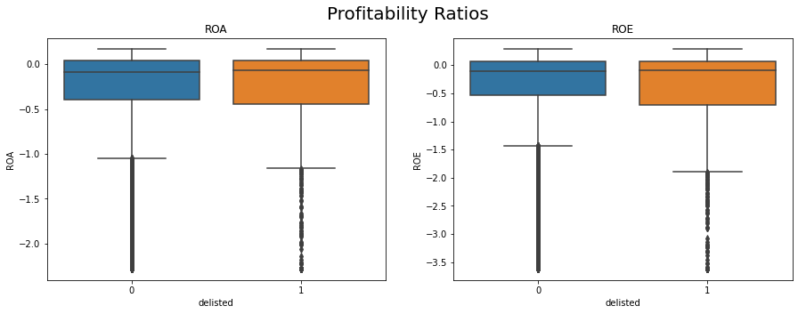
Profitability Ratios

Slide 12
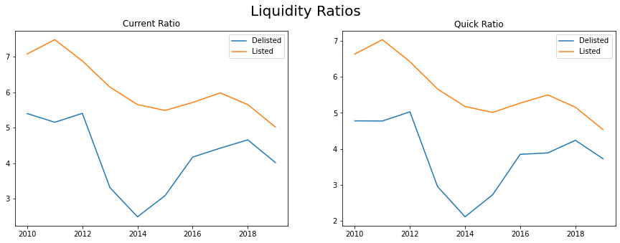
Liquidity Ratios

Slide 13
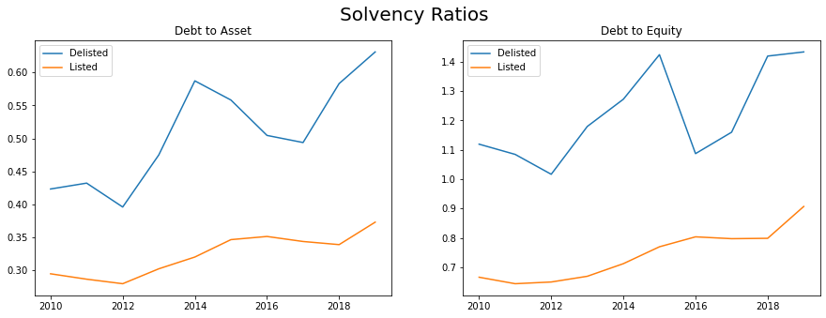
Solvency Ratios

Slide 14
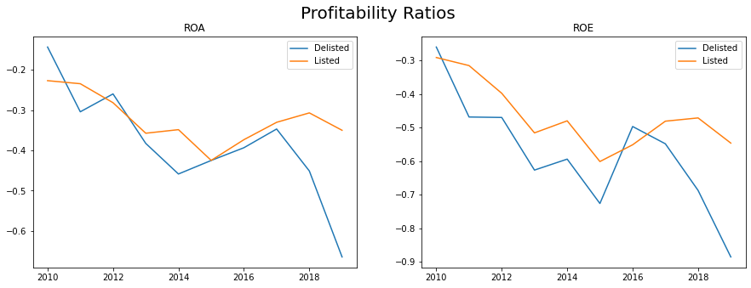
Profitability Ratios

Slide 15
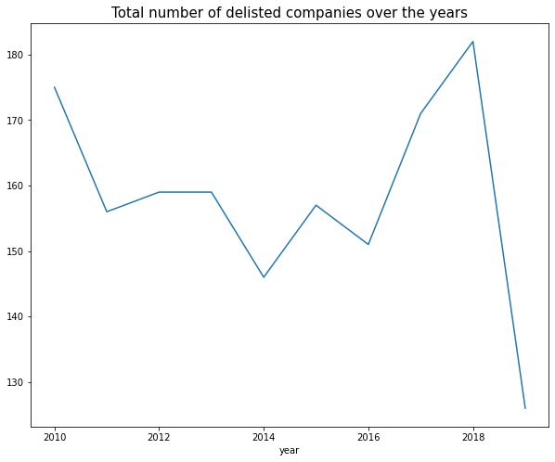
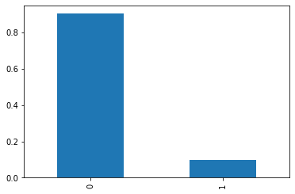
Trend of Delisted companies
 | Listed companies | Delisted companies
Proportion | 0.902 | 0.098

Slide 16

Classification Models
Performed standard scaling and SMOTE for under-sampling
Logistic Regression model
Support Vector Machines
Naïve Bayes
Performed cross validation along with KFold and RepeatedKFold

Slide 17
Classification Model results
 | Score | Cross validation score (cv=5) | Accuracy Score | Recall | Precision | f1-score | AUC
Logistic Regression | 0.61 | 0.61 | 0.59 | 0.54 | 0.60 | 0.57 | 0.63
Support Vector Machine | 0.60 | 0.60 | 0.58 | 0.38 | 0.64 | 0.48 | 0.63
Naïve Bayes | 0.59 | 0.59 | 0.58 | 0.41 | 0.62 | 0.49 | 0.62

Slide 18
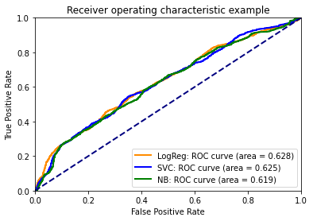
ROC curve

Slide 19
Logistic Regression (coefficients)
Current Ratio | -0.585
Quick Ratio | 0.622
Debt to Asset | 0.605
Debt to Equity | -0.095
Interest Coverage | 0.057
ROE | -0.027
ROA | 0.245
d_loss | 0.015
intercept | -0.105

Slide 20
Summary
Findings
  The means of financial ratios are statistically different between listed and delisted companies.
  Amongst the three classification models (Logistic regression, support vector machine, Naïve Bayes), Logistic regression is the best model which has the highest accuracy score, recall and area under curve.
Limitations
  The reasons for delisting have not been incorporated.
Future research
  Further analysis including different types of industry.
  Further analysis including other various factors including corporate governance.

Slide 21
Thank you
Any questions?

